Slide 1
Describing Things, Places & People
PICTURE DESCRIPTION

Slide 2
OVERVIEW
Adjectives
Describing people
Appearance, personality and emotions
Describe a picture
Structure
Impression
5 WHs
Rules to describe a picture
Activity

Slide 3
ADJECTIVES
An adjective is a describing word, the main syntactic role of which is to qualify a noun or noun phrase, giving more information about the object signified.

Slide 4
DESCRIBING PEOPLE
1. Describing someone’s appearance
2. Describing someone’s character and personality
3. Describing someone’s feelings & emotions

Slide 5
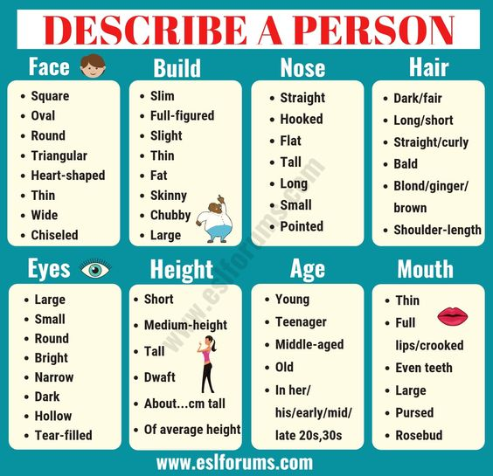
DESCRIBING PERSONS

Slide 6
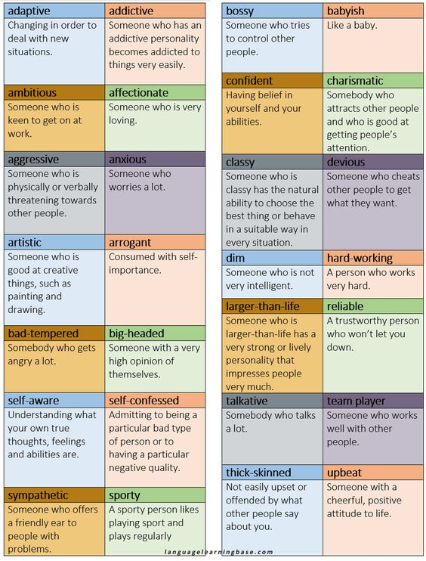
DESCRIBING PERSONALITY

Slide 7
DESCRIBING FEELINGS AND EMOTIONS
Positive Emotion
appreciative
blissful
contented
ecstatic
elated
serene
Optimistic
Vivacious

Slide 8
Negative Emotion
angry
disenchanted
distressed
glum
gloomy
grumpy
grouchy

Slide 9

ACTIVITY : DESCRIBE PEOPLE APPEARANCE

Slide 10
Describe a picture
Picture
Image
Painting
Photograph
Portrait
Cover
Cartoon
poster

Slide 11
Structure
Next/near to
In front of/ in the foreground
In the background
In the upper part/at the top
On the left hand-side/on the left
On the right hand-side/on the right
In the central part/in the mid

Slide 12
Impression
The character looks as ……
It seems, it appears
I think
I believe
I am sure

Slide 13
5 WHs
Who (subject)
what (things, person, place)
where (position, time of the day, location)
Why ( reason, culture,)
How (activities)

Slide 14
HOW TO DESCRIBE A PICTURE.
1st. Focus on the main part of the picture at the beginning. Look at this picture. What can you see?
2nd . Describe as much as you can.
3rd . Try to use your imagination to make assumptions

Slide 15

PICTURE DESCRIPTION

Slide 16
References
www.eslforums.com
www.britishcouncil.com

